Slide 1
Why MoneroV is Indistinguishable from a Scam
By xmrscott
2018/03/05

Slide 2
Topics Covered
MoneroV vs Monero
  Inflation
  Scalability
  Privacy
Red flag hunt
Mythbusting

Slide 3
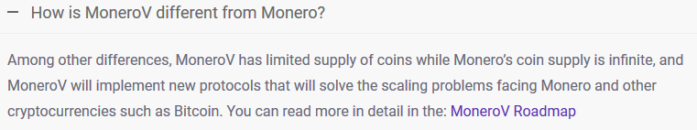

Slide 4
What is inflation?
“Inflation is the rate at which the general level of prices for goods and services is rising and, consequently, the purchasing power of currency is falling.” – Investopedia
Or put another way, if supply increases faster than demand, and all other things remaining equal, it takes more units to buy a good

Slide 5
What does MoneroV have to say?
“Bitcoin’s 21 million maximum coin supply was introduced specifically to avoid having a body that controls the money supply, completely restricting future inflation and devaluation of Bitcoin coins.
Based on this merit alone, Monero would never be able to compete with Bitcoin as the world’s best digital currency, since the idea of infinite coin supply is the incorrect intuition.
MoneroV adheres to core Austrian school of economics principles and caps the total amount of XMV coins that can be created to 256 million. The initial coin amount in circulation at the time of the hardfork would be 10 times the amount of XMR coins ( ~158 Million). XMR holders prior to the hard fork will receive 10 times the amount of XMV coins.”
-MoneroV Roadmap paper

Slide 6
Coin Supply – March 2018
MoneroV | 158,000,000
Monero | 15,800,000

Slide 7
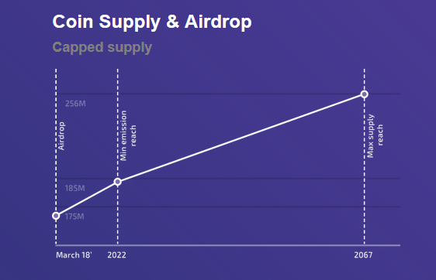
Coin Supply – 2067

Slide 8
Coin Supply – 2067
MoneroV | 256,000,000
Monero | 25,500,460
.3*60(minutes)*24(hours)*365.25(days) = 157,788 coins/year from tail emission
18.4 mil + 157,788x, where x = number of years after 2022

Slide 9
When Eclipse?
18.4 mil + 157,788x = 256mil
Solving for x yields ~1,505.8 years
  AKA ~3527 A.D.
0.06% inflation
  Will continue to approach 0

Slide 10
But…why?
“to differentiate the two cryptocurrencies while making the two cryptocurrency wallets - MoneroV’s and Monero’s - to reject one another’s blockchain.”

Slide 11
Why Tail Emission?
Tx 1 | .01 BTC
Tx 2 | .01 BTC
Tx 3 | .01 BTC
Tx 4 | .01 BTC
Tx 5 | .01 BTC
Tx 6 | .01 BTC
Tx 7 | .01 BTC
Tx 8 | .001 BTC

Slide 12
Dynamic Blocksize
“We first consider a blocksize large enough (or effectively infinite). In this scenario competition among miners will drive fees towards zero since there is no scarcity. This will in turn cause the difficulty and consequently the security of the crypto currency to collapse. We must keep in mind that orphan block based arguments will also fail since these are based on the presence of a base emission. This is in fact the very legitimate fear of the small block proponents.
[...]
Either the mining revenue collapses first or the purchasing power of the mining revenue collapses first.” – ArticMine

Slide 13
MoneroV on Scalability
“Monero does not scale. As of the time of this writing, Monero’s median transaction size excluding coinbase transactions is 51.2 times larger than Bitcoin’s median transaction size (13.21 kb vs 258 bytes). If Monero was to handle the cumulative transactions amounts of Bitcoin, its blockchain size would be higher than 7.7 Terabytes (in comparison to Bitcoin’s 155 Gigabyte blockchain). In turn, the fear from an imminent bloated juggernaut blockchain comes with higher median transaction fees than Bitcoin.
MoneroV plans to tackle the scaling issues, which is the main source of problems in Monero, and in all cryptocurrency coins for that matter, and integrate the MimbleWimble protocol so that the blockchain size will be bound to the number of users using MoneroV (not the number of transactions being made in the network). This will significantly reduce both transaction costs and blockchain size, permanently solving the scaling problem.”

Slide 14
MoneroV’s Scalability Solution
Inherits the 33GB Monero blockchain
Inherits said ~13kb tx size
Best estimate is Q4, 2019
  No demonstrable efforts to show this is obtainable
MoneroV’s intermittent scaling problem can be solved by…
Monero likely releasing Bulletproofs in September
  Code already published and working in testnet

Slide 15
Ring Confidential Transactions (RingCT)
Tx e5xq8ur
Tx o245bsd
? XMR
Tx cz7giry
RingCT Signature
To Stealth Address(es)
Tx qxp1cts
Tx wygykpj
Key Image
See: https://lab.getmonero.org/pubs/MRL-0005.pdf

Slide 16
MoneroV attacks its own privacy
Tx e5xq8ur
Tx 4abfd96
Tx o245bsd
Tx e12c38f
Tx cz7giry
Tx a68c1dd
Tx qxp1cts
Tx qxp1cts
Tx wygykpj
Tx 572f1e9
Key Image 1
Key Image 1

Slide 17
MoneroV attacks its own privacy (Cont’d)
Tx qxp1cts
Tx v1ifcnd
Tx hte60lj
Tx 572f1e9
Tx savh169
Key Image 42

Slide 18
MoneroV attacks its own privacy (Cont’d)
Tx v1ifcnd
Tx hte60lj
Tx 572f1e9
Tx savh169
Key Image 42

Slide 19
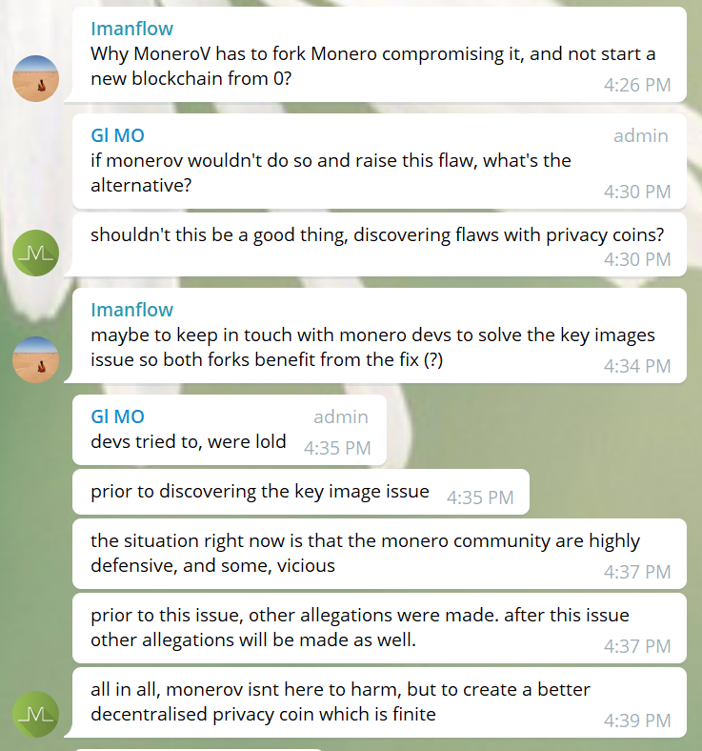
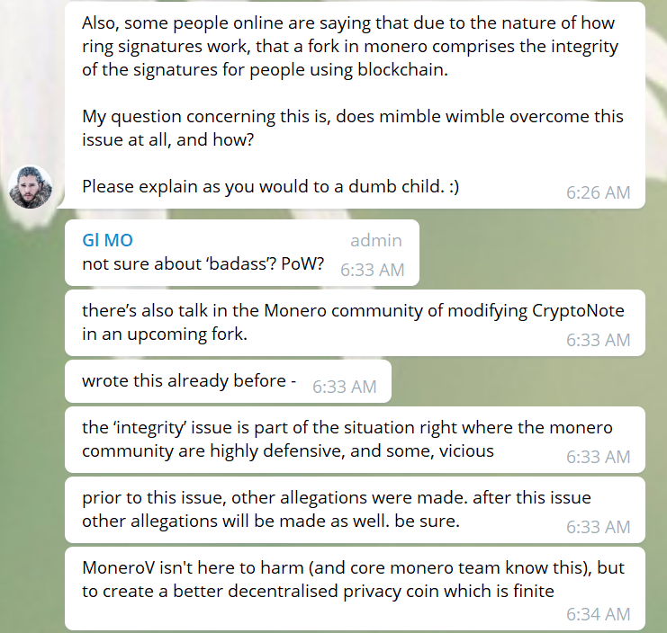
Primum non nocere

Slide 20
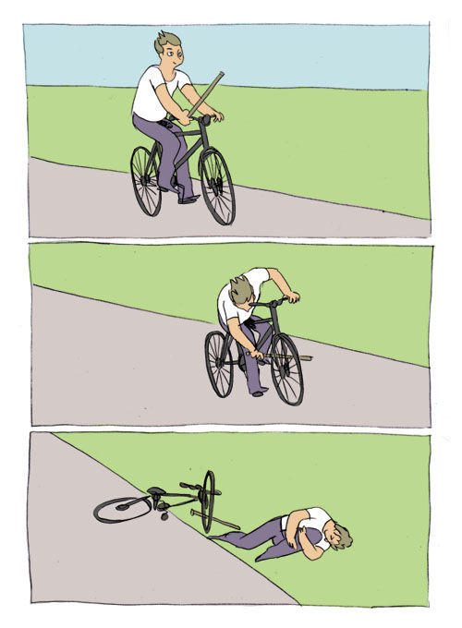
Between a rock and a hard place
MoneroV knew about it beforehand before Monero community raised the issue
  Are still proceeding with hurting their own users
MoneroV didn’t know about it before Monero community
  Are still proceeding with hurting their own users
How could this be avoided again…?

Slide 21
How can you protect yourself?
Don’t use XMV that you got from claiming
Don’t use XMR or XMV for roughly a week after XMV release

Slide 22
Conclusion
Coin supply/inflation
  XMV has more than XMR until ~3,500 AD
Scalability
  Hates bloat, but inheriting bloat is ok
Privacy
  Claims no intention to harm, proceeds to harm own users
How can MoneroV avoid all these issues?
  Say it with me… don’t do a chain split

Slide 23
Bonus Red Flag Round!
“we have brought many expert developers onboard”
  Four psuedonyms that took 22 commits to fork and make basic changes to xmr
    Nospawn last anything commit Feb 18th
    Vanfactory last commit March 2nd, prior Feb 16th
    Instanceme, Feb 9th
    Miltonf, Feb 18th

Slide 24
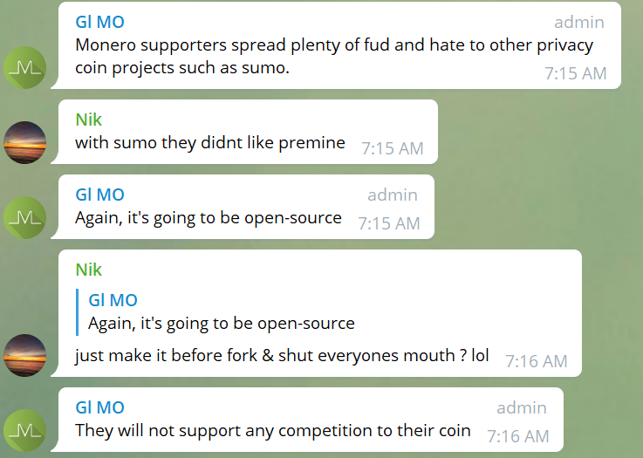
#1: Monero community hates competition?

Slide 25
#1: Not really
“I want competition in the space. It makes privacy as a whole better with innovation. I consider myself a privacy advocate, not a Monero advocate. I welcome competition to Monero, but I just want it to be good.” Diego AKA rehrar, Monero Contributor on a “competitor’s” forum
Smooth, a Monero Core Team member, has been Aeon’s lead developer since April 2015

Slide 26


#2: If I use a temp wallet, I’m still private?
1000 XMR
0 XMR

Slide 27
#2: If I use a temp wallet, I’m still private?
0 XMR
1000 XMR

Slide 28


#2: If I use a temp wallet, I’m still private?
0 XMR
1000 XMR
Same private key
0 XMR
1000 XMR

Slide 29
#2: If I use a temp wallet, I’m still private?
1000 XMR
0 XMR
0 XMR
1000 XMR

Slide 30
#2: If I use a temp wallet, I’m still private?
1000 XMR
0 XMR
1000 XMR
0 XMR

Slide 31
#2: No, not if you claim XMV
Tx e5xq8ur
Tx 4abfd96
Tx o245bsd
Tx e12c38f
Tx cz7giry
Tx a68c1dd
Tx qxp1cts
Tx qxp1cts
Tx wygykpj
Tx 572f1e9
Key Image 1
Key Image 1

Slide 32
#3 Devs are anonymous
“With an anonymous team, there is no recourse if something similar happens as did with the fork of bitcoin, bitcoin gold, where the development team promoted wallets containing malware.” – BTC Manager

